Slide 1
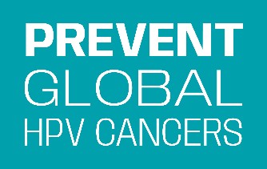
Cervical Cancer Elimination
through HPV Vaccination
Equipping Physicians to Prevent HPV Cancers

Slide 2
Important Instructions
Follow these instructions for use and adaptation of this slide deck
These slides were created to train physicians in India. In India, you may use the deck as-is with no changes other than adding or deleting slides. Adding your logo is allowed.
To adapt for other countries: You must replace all the included stock photos with photos you have legal rights to use to avoid copyright infringement. You can also add your logo and add/delete slides
Tips for modifying content are provided in comments on slides.
Speaker notes are included for each slide.
You must include the acknowledgement text on slide 76 as-is whenever using these slides.
Find additional details of use here.

Slide 3
Training Pre-Survey
Notes:
For ideas on question you can include in pre- and post-surveys, reference the surveys used with
Trainers – for virtual trainings please pause and copy the URL into the chat box for participants.

Slide 4
TODAY
Cervical Cancer: Burden & Impact
Human Papillomavirus (HPV) Infection
Cervical Cancer Prevention: HPV Vaccination
Communication: Making a Recommendation and Answering Parents’ Questions about HPV Vaccine
Notes:
Review agenda.

Slide 5
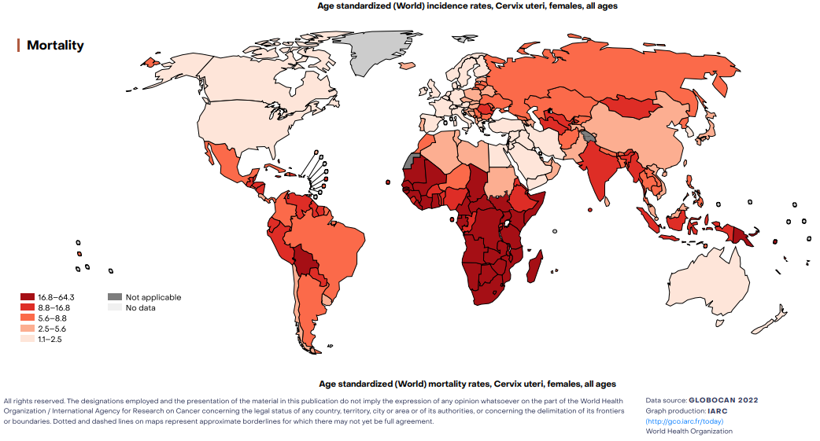
Global Burden
Notes:
Darker colors indicate higher mortality rate
Approximately 94% of the estimated 660,000 new cervical cancer cases and 350,000 deaths due to cervical cancer in 2022 occurred in low- and middle-income countries
This is because of differences in access to HPV vaccination, cervical screening, and treatment.
In high income countries, cervical cancer screening is an established part of routine health services for women
Inclusion of HPV vaccination as a routine vaccination has made the likelihood of eliminating cervical cancer a feasible goal for many high-income countries.
Where screening rates are low, the HPV vaccine is the best line of defense against cervical cancer.
Reference
World Health Organization. Cervical cancer [Internet]. 2022 Available from: https://www.who.int/news-room/fact-sheets/detail/cervical-cancer
Sung H, Ferlay J, Siegel RL, Laversanne M, Soerjomataram I, Jemal A, et al. Global cancer statistics 2020: GLOBOCAN estimates of incidence and mortality worldwide for 36 cancers in 185 countries. CA Cancer J Clin. 2021;71(3):209-24

Slide 6
India's Burden of Cervical Cancer, Annual
79K
Deaths
If we don't act ...
new cases will increase 54% from 2020 to 2040.
127K
New Cases
​Your ACTION today can change this picture of tomorrow!
Notes:
In 2022 more than 127,000 new cases of cervical cancer in India, (127,526)
79,000 cervical cancer deaths occurred in India. (79,906)
If we don't act new cases will increase 54% by 2040
During the short time of this presentation at least 9 Indian women may die of cervical cancer
Reference NICPR ICMR. Cancer Statistics - India Against Cancer [Internet]. 2022 .
356-india-fact-sheet.pdf
International Agency for Research on Cancer. India Globocan 2020 [Internet]. 2021 .
Source
Cancer Today website for chart data: https://gco.iarc.fr/tomorrow/graphic-isotype?type=0&population=900&mode=population&sex=2&cancer=39&age_group=value&apc_male=0&apc_female=0
Adjust the percent increase in new cases: Percentage Increase = [ (Final Value - Starting Value) / |Starting Value| ] × 100

Slide 7
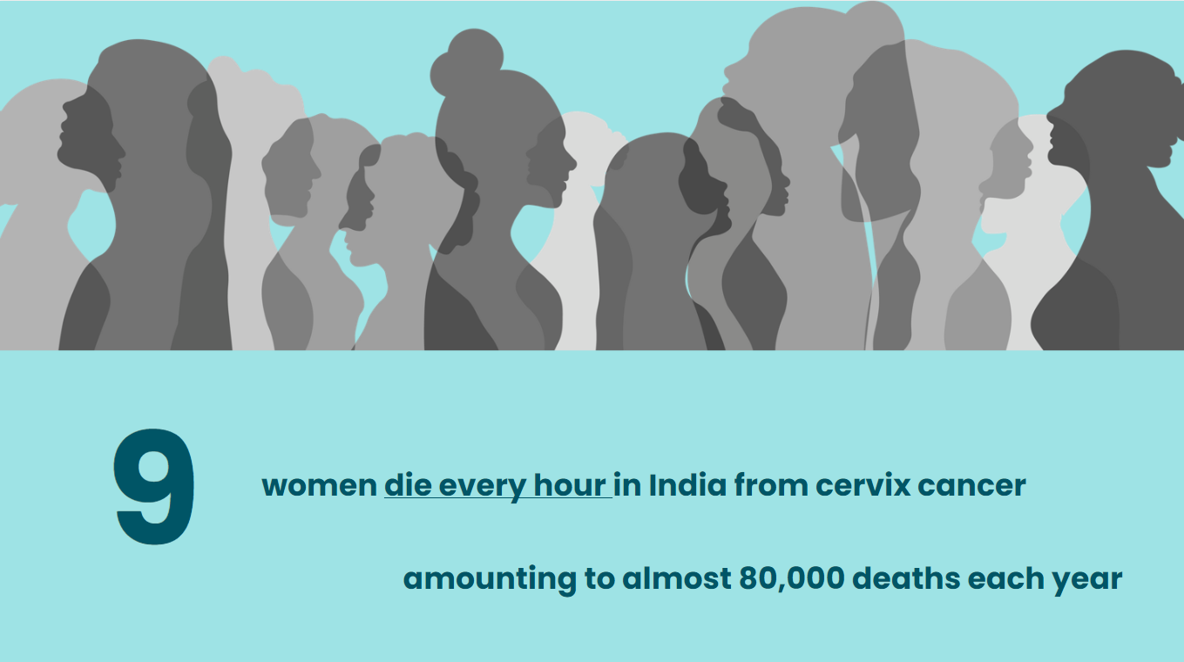
7 women will die of cervical cancer
during this 1 hour presentation

Slide 8
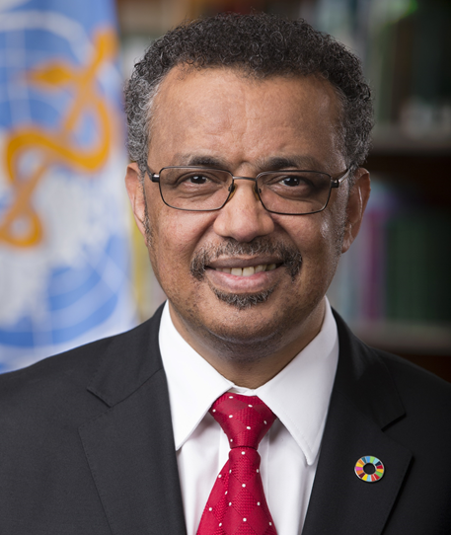
“Cervical cancer strikes women in the prime of life. These women are raising children, caring for their families and contributing to the social and economic fabric of their communities ...
if we don’t act, deaths from cervical cancer will rise (globally)...
But it doesn’t have to be this way ...”
– Dr Tedros Adhanom Ghebreyesus, WHO Director-General
Photo: Business Wire
Notes:
“Cervical cancer strikes women in the prime of life. These women are raising children, caring for their families and contributing to the social and economic fabric of their communities ...”
Global trends project an increase if we do not act
Cervical cancer can be prevented to save lives and keep families and keep communities intact and healthy.
No woman should die from cervical cancer.

Slide 9
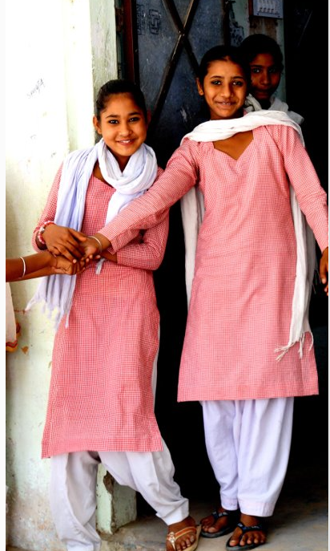
For the first time in history…
We can eliminate a cancer

Slide 10
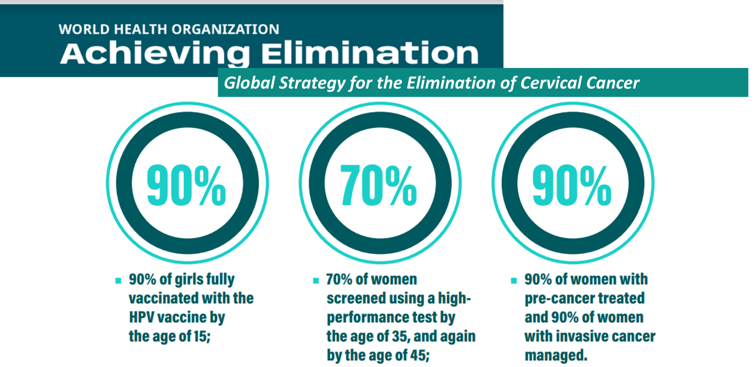
Notes:
The WHO Elimination Strategy lays out clear targets toward cervical cancer elimination.
Meeting and maintaining the 90-70-90 targets would yield significant returns in the coming century
the median cervical cancer incidence rate will fall by 42% by 2045, and by 97% by 2120, averting more than 74 million new cases of cervical cancer; and
the median cumulative number of cervical cancer deaths averted will be 300 000 by 2030, over 14 million by 2070, and over 62 million by 2120.
Source:
230519-ccei-brochure.pdf (who.int)

Slide 11
Cervical Cancer Prevention Strategy
to Reach Elimination
HPV vaccination in girls
Screening in women
9-14
YEARS
OLD
35
YEARS
OLD
45
YEARS
OLD
HPV VACCINATION
CERVICAL CANCER SCREENING
2 times in lifetime using a high- performance screening test
WHO – Cervical Cancer Elimination Initiative
Notes:
There is no cure for HPV infection which is why preventing it with HPV vaccination is so important.
Currently there are only two ways to effectively prevent cervical cancer.
These methods work in two different ways and at two different time periods during a woman’s life to prevent cervical cancer.
Primary prevention:
Target HPV vaccination of girls ages 9 – 14, which works by protecting them from HPV infection that causes cervical cancer.
Extended Age Group: 15 – 26 year old girls should also be vaccinated if they weren't already and cost allows.
The vaccine is labeled for women up to age 45, but there is little efficacy at older ages and it's not universally recommended.
Secondary prevention: Screen women twice in their lifetime using a high performance screening test
Source
World Health Organization. Cervical Cancer Elimination Initiative. [Internet]. https://www.who.int/initiatives/cervical-cancer-elimination-initiative
Kaarthigeyan K. Cervical cancer in India and HPV vaccination. Indian J Med Paediatr Oncol. 2012;33(1):7-12. Available from https://pubmed.ncbi.nlm.nih.gov/22754202/
CDC. Human Papillomavirus (HPV). https://www.cdc.gov/hpv/parents/vaccine-for-hpv.html#:~:text=HPV%20vaccination%20is%20not%20recommended,benefits%20of%20vaccination%20for%20them
National Cancer Institute. Cervical Cancer Screening [Internet] . Available from: https://www.cancer.gov/types/cervical/screening

Slide 12
Doctors are critical to meeting
elimination targets

Slide 13
FACT CHECK 1
Q: How many women die each year in India from cervical cancer?
A: 29,000
B: 49,000
C: 79,000
Please respond in the chat box
Notes:
Q: How many women die each year in India from cervical cancer?
A: 29000
B:49000
C: 79000
ANSWER: C 79000

Slide 14
FACT CHECK 1
Q: How many women die each year in India from cervical cancer?
A: 29,000
B: 49,000
C: 79,000 (correct answer)
Please respond in the chat box
Notes:
Q: How many women die each year in India from cervical cancer?
A: 29000
B:49000
C: 79000
ANSWER: C 79000

Slide 15
What Causes Cervical Cancer?
Human Papilloma virus (HPV)
Models used for illustrative purposes only.
Notes:
We've discussed the burden of cervical cancer, now we will review the cause of cervical cancer, the Human Papillomavirus (HPV) infection.

Slide 16
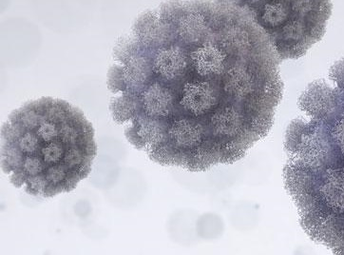
What is HPV?
Human Papillomavirus
> 200 types
At least 14 types of HPV can cause 6 types of cancer in men and women: cancer of the cervix, vulva, vagina, penis, anus, and oropharynx
Notes:
Human papillomavirus (HPV) is a small, non-enveloped deoxyribonucleic acid (DNA) virus that infects skin or mucosal cells.
At least 14 of more than 200 known HPV genotypes can cause cancer of the:
Cervix, vagina, and vulva in women
Penis in men
Anus in both men and women
Back of the throat, including the base of the tongue and tonsils (oropharynx), in both men and women
Sources:
In India, 84% of cervical cancers caused by HPV 16 and 18 - Bhatla N. Elimination of Cervical Cancer and the Role of HPV Vaccination [Internet]. 2020 . Available from: https://projectsanchar.org/wp-content/uploads/2020/02/Elimination-of-Cervical-Cancer-and-the-Role-of-HPV-Vaccination-Dr-Neerja-Bhatla.pdf
> 150 types - Centers for Disease Control and Prevention. Human Papillomavirus (HPV) Infection [Internet]. 2021. Available from: https://www.cdc.gov/std/treatment-guidelines/hpv.htm
WHO: https://www.who.int/teams/health-product-policy-and-standards/standards-and-specifications/vaccine-standardization/human-papillomavirus
About 14 types of HPV can cause cancer- Klemp Gjertsen M, Nilsen E, Alfsen GC, Feiring B, Skjeldestad FE, Steen R, Sæterdal I. Prophylactic Vaccines Against Human Papillomavirus [Internet]. https://pubmed.ncbi.nlm.nih.gov/29319982/

Slide 17





HPV Infection is very common
HPV infects both men and women alike.
An estimated >50% – 80% will get at least one type of HPV infection in their lifetime.
Most HPV infections do not have symptoms
The body fights off most HPV infections in about 2 years, but not all
If the HPV does not go away on its own, it can cause changes in healthy cells.
Notes:
HPV infection is very common
HPV infects both men and women alike.
> 50% - 80% (depending on year of study and country), will have at least one type of HPV infection in their lifetime - [NOTE: these figures apply to populations before introduction of vaccine, or to older cohorts who missed the opportunity to be vaccinated]
Most HPV infections with the types of HPV that can cause cancer do not cause any symptoms until they've progressed to precancer or cancer.
The body’s immune system will fight off most HPV infections.
Most people never know they are infected.
But if the HPV infection in the cervix does not go away on its own, it causes changes in cervix cells.
People will only know they have had HPV infection if they develop precancer, cancer, or anogenital warts, or if they have a positive HPV test
Source
National Cancer Institute. Understanding Cervical Changes - A Health Guide. Available from https://www.cancer.gov/types/cervical/understanding-abnormal-hpv-and-pap-test-results/understanding-cervical-changes.pdf
https://www.euro.who.int/__data/assets/pdf_file/0009/356841/Q-and-A_HPV_Parents_EN.pdf
Kaarthigeyan K. Cervical cancer in India and HPV vaccination. Indian J Med Paediatr Oncol. 2012 ;33(1):7-12. Available from https://www.ncbi.nlm.nih.gov/pmc/articles/PMC3385284/#ref3
Best SR, Niparko KJ, Pai SI. Biology of human papillomavirus infection and immune therapy for HPV-related head and neck cancers. Otolaryngol Clin North Am. 2012;45(4):807-22 Available from Biology of Human Papillomavirus Infection and Immune Therapy for HPV-Related Head and Neck Cancers - ScienceDirect
The epidemiology of genital human papillomavirus infection - ScienceDirect
The Estimated Lifetime Probability of Acquiring Human Papillomavirus in the United States - PMC (nih.gov)
https://journal.waocp.org/article_33037_4ca3d55e1f982fe4e19221b9dacc49f4.pdf

Slide 18
How is HPV spread?
HPV can be spread through a single exposure
HPV is spread through skin-to-skin mucosal contact, primarily (not exclusively) during sexual contact
HPV vaccination is the most effective method of primary prevention.
Notes:
HPV infection is easily spread through skin-to-skin and skin-to-mucosa contact with infected areas, primarily during sexual contact.
However, HPV has also been demonstrated to be spread by non-sexual means, including self-inoculation (from one part of the body to another) and from mother to child during childbirth.
Condoms provide limited protection and cannot completely prevent the spread of HPV infection. This is because HPV is not passed through bodily fluids like HIV. HPV is passed through skin-to-skin mucosal contact.
Because it is so common, HPV can spread even if someone delays sex until marriage, has only one partner, or limits the number of sexual partners.
HPV infection cannot be transmitted by shaking hands, sharing clothes, or using public toilets.
HPV vaccination is the most effective method of prevention. Cervical cancer screening is very effective and important, but HPV vaccination is even more effective when given at the recommended ages.
Skin-to-Skin mucosal contact can include contact or intercourse between any of the following: vagina, vulva, penis, anus, mouth/throat.
Source
Liu Z, Rashid T, Nyitray AG. Penises not required: a systematic review of the potential for human papillomavirus horizontal transmission that is non-sexual or does not include penile penetration. Sex Health. 2016 ;13(1):10-21.Available from https://pubmed.ncbi.nlm.nih.gov/26433493/,
Petca A, Borislavschi A, Zvanca ME, Petca RC, Sandru F, Dumitrascu MC. Non-sexual HPV transmission and role of vaccination for a better future (Review). Exp Ther Med. 2020;20(6):186.Available from https://pubmed.ncbi.nlm.nih.gov/33101476/ ,
Moscicki AB, Schiffman M, Burchell A, Albero G, Giuliano AR, Goodman MT, et al. Updating the natural history of human papillomavirus and anogenital cancers. Vaccine. 2012 ;30 Suppl 5(0 5):F24-33. Available from https://www.ncbi.nlm.nih.gov/pmc/articles/PMC3700362/
Winer RL, Hughes JP, Feng Q, O'Reilly S, Kiviat NB, Holmes K, Et al. Condom Use and the Risk of Genital Human Papillomavirus Infection in Young Women. N Engl J Med 2006; 354:2645-2654. Available from https://www.nejm.org/doi/full/10.1056/nejmoa053284

Slide 19
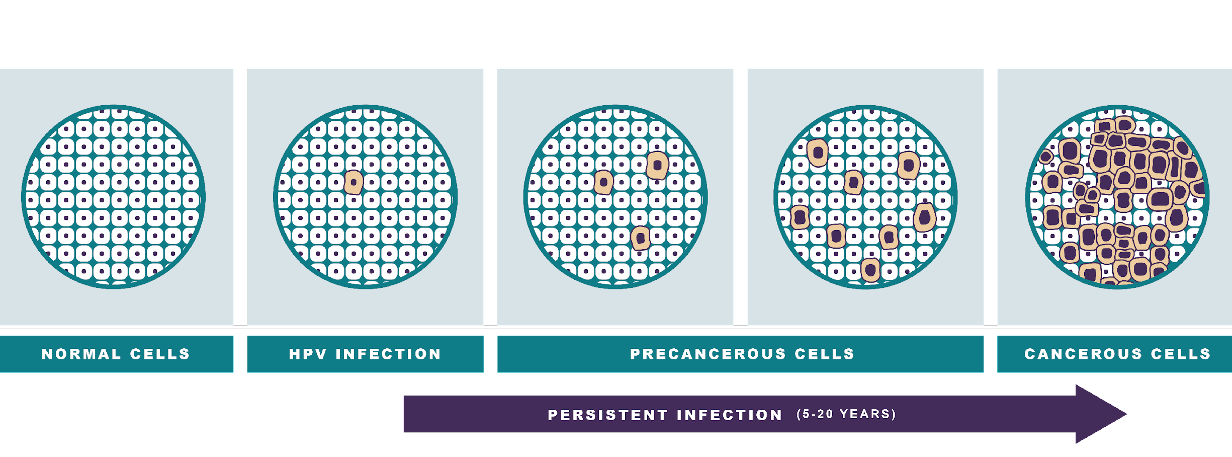
How does HPV infection progress to cervical cancer?
Notes:
While HPV can cause 6 types of cancers, the focus of remainder of this presentation will focus on the most common HPV-related cancer: cervical cancer.
A subset of HPV types is responsible for virtually all cases of cervical cancer.
HPV infection causes cervical cancer over the course of many years in three general phases:
1)High-risk HPV infection leading to abnormal cell development and growth
2) infection persistence leading to precancerous lesions,
3) precancer development into cervical cancer
Cervical precancerous cells or precancers are not cancer and usually do not have any symptoms.
If not identified and treated with preventive therapy in time these precancers can become cancer
The long time period (usually decades) between HPV infection and the development of cervical cancer provides an opportunity to prevent cervical cancer in women by identifying and treating these precancers. We will discuss this again later in the course during cervical cancer prevention.
Citation:
https://www.who.int/news-room/fact-sheets/detail/cervical-cancer
https://www.cdc.gov/hpv/parents/cancer.html

Slide 20
Which HPV infections become cancer?
High-risk HPV type
Persistent
+
types of HPV that can cause cancer
infections not controlled over time
Notes:
Cervical cancer requires two conditions to develop:
1) Infection with a high-risk (oncogenic) type of HPV and
2) that high-risk HPV infection must persist over time instead of being controlled by the body’s immune system
A “high-risk” type of HPV is a type that can cause cancer. Only about 14 types out of the over 150 types of HPV can cause cancer
Infections with high-risk types of HPV can cause six types of cancers; cervical, vulvar, vaginal, penile, anal, and oropharyngeal.
Persistent HPV infections that are not controlled by body’s immune system over many years, even decades, can lead to cancer
It is not possible to know which HPV infections will persist and which will not
However, factors that increase the risk for persistent HPV infection include smoking, alcohol use, and a weakened immune system (for example, due to HIV infection or other immune disease).
Reference: - Burd EM. Human papillomavirus and cervical cancer. Clin Microbiol Rev. 2003 ;16(1):1-17. Available from https://www.ncbi.nlm.nih.gov/pmc/articles/PMC145302/
https://journal.waocp.org/article_33037_4ca3d55e1f982fe4e19221b9dacc49f4.pdf

Slide 21
Most cervical cancers are caused by HPV
In India, 84% of cervical cancers are caused by HPV types 16 and 18
Persistent HPV infection causes cervical cancer.
HPV vaccination is the best way to prevent HPV infections and cervical cancer.
Notes:
Persistent HPV infection can cause cervical cancer.
In India, 84% of cervical cancers are caused by HPV 16 and 18
The two most common "high-risk" genotypes (HPV 16 and 18) cause approximately 84% of all cervical cancers in India, more than the global average of 70%.
HPV infection is the main cause for cervical cancers with PAF (population attributable fraction) ranging between 93% and 100% in India.
*** Hygiene and cervical cancer ***
Good hygiene is important for the overall health and wellbeing of a woman.
Almost all cervical cancer is caused by persistent HPV infection.
Even populations with excellent hygiene are at risk of HPV infection and cervical cancer – National HPV vaccination programs and high HPV vaccination rates in countries like Australia, UK are a testament to that.
HPV infections are very common. Most people get it at some point in their life, even those with good hygiene.
HPV vaccination is the best way to prevent HPV infections and cervical cancer.
Source
National Cancer Institute. Understanding Cervical Changes - A Health Guide. Available from https://www.cancer.gov/types/cervical/understanding-abnormal-hpv-and-pap-test-results/understanding-cervical-changes.pdf
https://www.euro.who.int/__data/assets/pdf_file/0009/356841/Q-and-A_HPV_Parents_EN.pdf
Kaarthigeyan K. Cervical cancer in India and HPV vaccination. Indian J Med Paediatr Oncol. 2012 ;33(1):7-12. Available from https://www.ncbi.nlm.nih.gov/pmc/articles/PMC3385284/#ref3
Best SR, Niparko KJ, Pai SI. Biology of human papillomavirus infection and immune therapy for HPV-related head and neck cancers. Otolaryngol Clin North Am. 2012;45(4):807-22 Available from Biology of Human Papillomavirus Infection and Immune Therapy for HPV-Related Head and Neck Cancers - ScienceDirect
https://www.ncbi.nlm.nih.gov/pmc/articles/PMC9666279/#sec-11title
https://journal.waocp.org/article_33037_4ca3d55e1f982fe4e19221b9dacc49f4.pdf

Slide 22
FACT CHECK 2
Q: Persistent HPV infection can cause which type of cancer?
A: Cervix and Oropharynx
B: Cervix, Vulva, and Vagina
C: Cervix, Anus, and Penis
D: All of the above
Please respond in the chat box
Notes:
Q: Persistent HPV infection can cause what type of cancer:
Answer: All of the above: cancer of the cervix, vulva, vagina, penis, anus, and oropharynx

Slide 23
FACT CHECK 2
Q: Persistent HPV infection can cause which type of cancer?
A: Cervix and Oropharynx
B: Cervix, Vulva, and Vagina
C: Cervix, Anus, and Penis
D: All of the above (correct answer)
Please respond in the chat box
Notes:
Q: Persistent HPV infection can cause what type of cancer:
Answer: All of the above: cancer of the cervix, vulva, vagina, penis, anus, and oropharynx

Slide 24
Preventing HPV Infections:
HPV Vaccine Facts
Models used for illustrative purposes only.
Notes:
We cannot treat our way out of the cervical cancer epidemic: we must work to prevent cervical cancer.
We're going to cover basic facts about the HPV vaccine, which is the most effective method for cervical cancer prevention

Slide 25
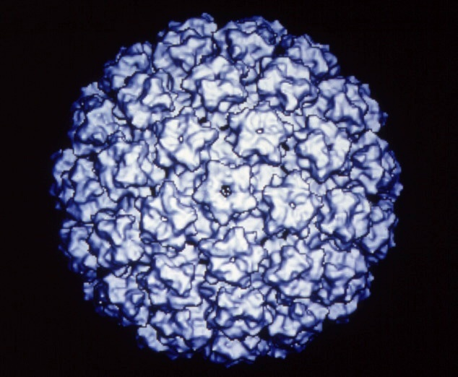
HPV Prophylactic Vaccines
Recombinant L1 capsid proteins that form "virus like" particles (VLP)
Non-infectious and non-oncogenic
Produce higher levels of neutralizing antibody than natural infection
HPV VLP
Adapted from Dr. Rebecca Perkins’ slides
Notes:
First introduced in 2006, current HPV vaccines are prophylactic, i.e., to be administered prior to exposure with HPV
HPV vaccines are made from virus-like particles that cannot cause infection with HPV or cause cancer. HPV vaccines produce a better immune response than an HPV infection.

Slide 26
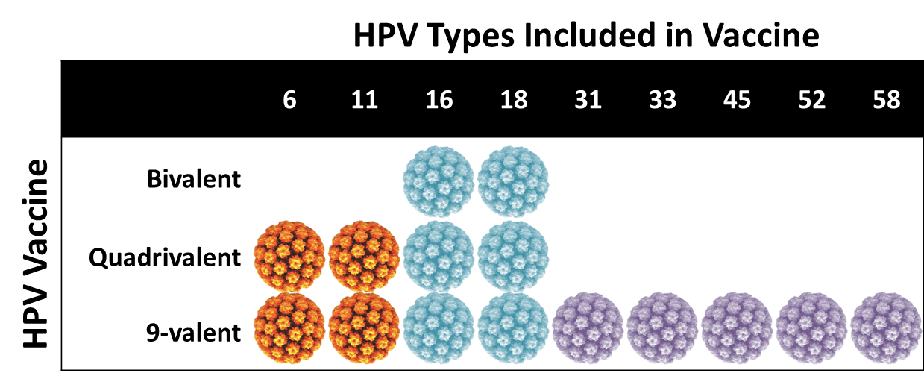
HPV Vaccines Comparison
90% of Genital warts
> 70% of cervical cancers globally caused by HPV 16 & 18
15-20% of
cervical cancers globally
Adapted from CDC You Are The Key & Douglas E. Lowy, J Clin Invest DOI: 10.1172/JCI85446
Notes:
This chart demonstrates the HPV types targeted by three different HPV vaccine types.
Bivalent HPV vaccine targets two types of HPV
quadrivalent HPV vaccine targets four types of HPV
9-valent HPV vaccine targets nine types of HPV.
Bivalent, quadrivalent, and 9-valent HPV vaccines all protect against HPV 16 and 18, the HPV types that cause about 70% globally
Quadrivalent and 9-valent HPV vaccines also protect against HPV 6 and 11, HPV types that cause anogenital warts.
In addition, 9-valent HPV vaccine targets five additional cancer-causing types, which account for another 15 – 20% of cervical cancers worldwide. The additional five types in 9-valent HPV vaccine account for a higher proportion of HPV-associated cancers in women compared with men.
Sources:
Feixue Wei, et al, Lancet https://www.sciencedirect.com/science/article/abs/pii/S0140673624010973#:~:text=In%20this%20study%2C%20we%20present,an%20additional%2015%E2%80%9320%25.
Douglas E. Lowy, J Clin Invest DOI: 10.1172/JCI85446
National Cancer Institute. https://www.cancer.gov/about-cancer/causes-prevention/risk/infectious-agents/hpv-vaccine-fact-sheet#:~:text=The%20trials%20that%20led%20to,that%20it%20targets%20(10).

Slide 27
HPV Vaccination Facts
HPV vaccine is effective
HPV vaccine is safe
HPV vaccination can start at age 9
YOUR recommendation matters
Notes:
The HPV Vaccine is cervical cancer prevention
In addition to preventing cervical cancer...
HPV vaccine works well and provides protection against cervical cancer well into adulthood
HPV vaccine is extremely safe
HPV vaccines are licensed to start at age 9
You are a valued and trusted source of information for parents

Slide 28
FACT:
HPV VACCINATION
IS EFFECTIVE
Notes:
HPV vaccination is effective at preventing cancer as well as precancer and HPV infections

Slide 29
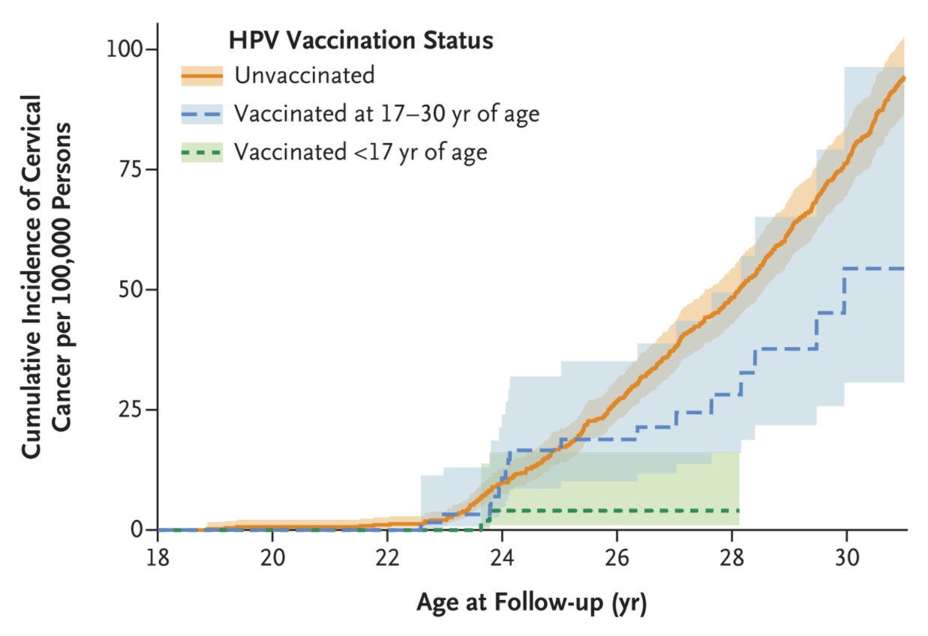
HPV Vaccination is Effective
Sweden, 2020: 1.7 million females who were 10-30 yrs. of age between 2006 through 2017 were followed and evaluated until their 31st birthday.​
Key Findings:
538 cases in 528,000 unvaccinated
19 cases in 518,000 vaccinated
2 cases in 439,000 vax age 10-16 yrs.
17 cased in 90,000 vax 17-30 yrs.
88% protection against invasive cervical cancer when vaccinated before age 17
SOURCE: Lei, et al, NEJM 2020
Notes:
This study used quadrivalent vaccine.
Sweden, 2020: 1.7 million females who were 10-30 yrs. of age between 2006 through 2017 were followed and evaluated until their 31st birthday.
Most of the 10-16 year olds were vaccinated close to age 12 and most of the 17 – 30 year olds were vaccinated close to age 17.
Key findings:
538 cases in 528,000 unvaccinated
19 cases in 518 vaccinated
2 cases in 439,000 vax age 10 – 16 yrs
17 cases in 90,000 vaccinated age 17 - 30
Reference : Jiayao Lei J, Ploner A, Elfström KM, Wang J, Roth A,Fang et al. HPV Vaccination and the Risk of Invasive Cervical Cancer
N Engl J Med 2020; 383:1340-1348. Available from https://www.nejm.org/doi/full/10.1056/NEJMoa1917338

Slide 30
HPV Vaccination is Effective
IARC-India Trial/Observational Study, Published 2024
 | Unvaccinated | 1 dose | 2 doses (days 1 and ≥180) | 3 doses (days 1, 60, and ≥180)
No. of Women assessed | 1273 | 3022 | 2311 | 2172
Persistent HPV 16 and/or 18 infections
Observed events | 35 | 4 | 2 | 2
Crude attack rates, % | 2.7 | 0.1 | 0.1 | 0.1
Vaccine efficacy, % |  | 92.0 | 94.8 | 95.3
95% CI |  | (87.0-95.0) | (90.0 - 97.3) | (90.9 - 97.5)
Sylla G Malvi, Pulikkottil O Esmy, Richard Muwonge, et al. A prospective cohort study comparing efficacy of 1 dose of quadrivalent human papillomavirus vaccine to 2 and 3 doses at an average follow up of 12 years post-vaccination, JNCI Monographs, Volume 2024, Issue 67, October-November 2024, Pages 317–328, https://doi.org/10.1093/jncimonographs/lgae042
Notes:
Highlights findings from the IARC study, which has consistently reported on the immunogenicity and efficacy of the HPV Vaccine over the past 15 years.
The study compared the efficacy of 1, 2, and 3 doses of the vaccine against persistent HPV 16 and 18 infections.
There was no significant difference in efficacy between receiving 1 dose or more.
Specifically, vaccine efficacy, adjusted for the number of infections with HPV types was:
92.0% (95% CI = 87.0% to 95.0%) for 1 dose.
94.8% (95% CI = 90.0% to 97.3%) for 2 doses.
95.3% (95% CI = 90.9% to 97.5%) for 3 doses.

Slide 31
HPV Vaccination is Effective
IARC-India Trial/10 years post vaccination, 2024
Study Group | Women assessed (N) | Persistent HPV 16/18 infection % (95% CI) | Persistent HPV 31/33/45 infection % (95% CI)
Unvaccinated | 1,273 | 2.7 (1.9-3.8) | 1.3 (0.8-2.1)
All vaccinated | 9,708 | 0.1 (0.1-0.2) | 0.6 (0.4-0.7)
3- dose | 2,172 | 0.1 (0.0-0.3) | 0.7 (0.4-1.2)
2- dose (D 1 & 180+) | 2,311 | 0.1 (0.0-0.3) | 0.8 (0.5-1.2)
1- dose | 3,022 | 0.1 (0.0-0.3) | 0.6 (0.3-0.9)
Journal of the National Cancer Institute Monographs, 2024, 2024(67), 317–328
Notes:
Data from the WHO-IARC HPV Vaccine trial, which became an observational study in 2010, show the vaccine is effective in preventing cervical cancer.
Results: - At 4 years post-vaccination - no persistent HPV 16 or 18 infections were detected (when participants were 14–22 years).
- At 7 years post-vaccination - The rates of persistent HPV16 or HPV18 infection were 0.2% (95%CI 0.0–0.9%) in the three-dose arm, 0% each in two-dose and single-dose arms and 1.2% (95% CI 0.7–2.1%) in the unvaccinated women.
- After 10 years post-vaccination: The rates of persistent HPV16 or HPV18 infection is 0.1% in all three vaccinated arms compared to 2.7% in unvaccinated arm
- HPV vaccination is effective in preventing cervical cancer.
More Background:
In April 2010, when the Indian government suspended all HPV vaccine trials for reasons not related to the WHO-IARC HPV Vaccine Trial, 17,729 participants (88.6% of the targeted recruitment of 20,000 girls) had been recruited; many had not yet completed their full dose schedules – some had received only one, some two, and some all three.
The trial became an observational study!
A supplementary cohort of married, unvaccinated females aged 18–23 years (corresponding to the age of the married vaccinated females at the time of follow up) was recruited from different study sites in India during 2012 to 2015, allowing comparison of HPV infection data between participants vaccinated with one, two or three doses and those who had not received any vaccine doses
Collection of cervical samples commenced six months after delivery of a baby or 12 months after marriage, whichever was earlier

Slide 32
FACT:
HPV VACCINATION
IS SAFE
Notes:
HPV vaccination is effective at preventing cancer as well as precancer and HPV infections

Slide 33
HPV Vaccines are Safe
>500 M doses globally by 2022
“Excellent Safety profile”
WHO Global Advisory Committee on Vaccine Safety (GACVS)
Statement on the continued safety of HPV vaccination (2017)
“Since licensure of HPV vaccines, GACVS has found no new adverse events of concern based on many very large, high-quality studies. The new data presented at this meeting have strengthened this position.”
Notes:
(WHO SAGE Position Paper 2022)Since licensure in 2006, over 500 million doses of HPV vaccines have been distributed. Post-licensure surveillance has detected no serious safety issues to date except rare reports of anaphylaxis
Since the first marketing authorization in 2006, post-licensure monitoring and research have been conducted for the 3 vaccines (bivalent by GlaxoSmithKline, quadrivalent and 9-valent by Merck and Co.), with over 109 studies completed in several countries.
HPV vaccines were found to have a favourable safety profile, with no confirmed clinically serious signals about safety. Anaphylaxis and syncope are known AEs.
We know that we can expect HPV vaccination to cause some injection site reactions, possibly fever, and headache.
We know that anyone who has any severe allergies, including an allergy to yeast, anyone who has ever had a life-threatening allergic reaction to any component of HPV vaccine or to a previous dose of HPV vaccine, should not be vaccinated.
We also know that fainting spells, or syncope, is very common with adolescents when they receive injections.
To reduce the risk of syncope, patients should be seated while vaccinated and remain in that position or should lay down for 15 minutes.
Sources:
WER9750-645-672-eng-fre.pdf
WHO Global Advisory Committee on Vaccine Safety Statement on HPV vaccination 2017
Genovese C, LA Fauci V, Squeri A, Trimarchi G, Squeri R. HPV vaccine and autoimmune diseases: systematic review and meta-analysis of the literature. J Prev Med Hyg. 2018 Sep 28;59(3):E194-E199. Available from https://www.ncbi.nlm.nih.gov/pmc/articles/PMC6196376/
HPV Vacs . Vaccinate adolescents against cancer . Available from https://www.cancer.org/content/dam/cancer-org/online-documents/en/pdf/flyers/hpv-vacs-just-the-facts-for-providers.pdf
Arbyn M, Xu L, Simoens C, Martin‐Hirsch PP. Prophylactic vaccination against human papillomaviruses to prevent cervical cancer and its precursors. Cochrane Database of Systematic Reviews [Internet]. 2018 ;(5). Available from: https://www.cochranelibrary.com/cdsr/doi/10.1002/14651858.CD009069.pub3/full
https://www.who.int/groups/global-advisory-committee-on-vaccine-safety/topics/human-papillomavirus-vaccines/infertility

Slide 34
HPV Vaccination Has Long-term Safety Data
No greater Anaphylaxis, GBS, stroke, blood clots, appendicitis, seizures (than unvaccinated or who received other vaccines)
No Blood clots or adverse events related to immune system & central nervous system (almost 1 million girls)
No increased risk of…
No Venous thromboembolism or blood clots (>1 million women)
No Multiple sclerosis or other demyelinating diseases
No Primary ovarian insufficiency, rheumatologic conditions
No Autoimmune disorders
And 60+ other conditions
2011
2012 & 2014
2013
2014
2015
2018
SOURCES: Cochrane Review, Arbyn, 2018, WHO SAGE HPV Vaccines Position Paper, 2022
Notes:
HPV vaccine safety is better studied than most vaccines.
Data from all sources continue to show that HPV vaccines currently in global use are very safe
Data are reassuring that HPV vaccine does not increase risk of Guillain-Barré syndrome, Bell’s palsy, complex regional pain syndrome (CRPS), or postural orthostatic tachycardia syndrome (POTS).
No association was found between HPV vaccination and infertility
Studies with almost 4 million people showed no relationship between the HPV vaccine and autoimmune disorders, blood clots, or other serious disorders.
Monitoring systems are in place in more than 80 countries to ensure that HPV vaccine, and all vaccines recommended for children and adolescents, are safe.
Sources
Genovese C, LA Fauci V, Squeri A, Trimarchi G, Squeri R. HPV vaccine and autoimmune diseases: systematic review and meta-analysis of the literature. J Prev Med Hyg. 2018 Sep 28;59(3):E194-E199. Available from https://www.ncbi.nlm.nih.gov/pmc/articles/PMC6196376/
HPV Vacs . Vaccinate adolescents against cancer . Available from https://www.cancer.org/content/dam/cancer-org/online-documents/en/pdf/flyers/hpv-vacs-just-the-facts-for-providers.pdf
Arbyn M, Xu L, Simoens C, Martin‐Hirsch PP. Prophylactic vaccination against human papillomaviruses to prevent cervical cancer and its precursors. Cochrane Database of Systematic Reviews [Internet]. 2018 ;(5). Available from: https://www.cochranelibrary.com/cdsr/doi/10.1002/14651858.CD009069.pub3/full

Slide 35
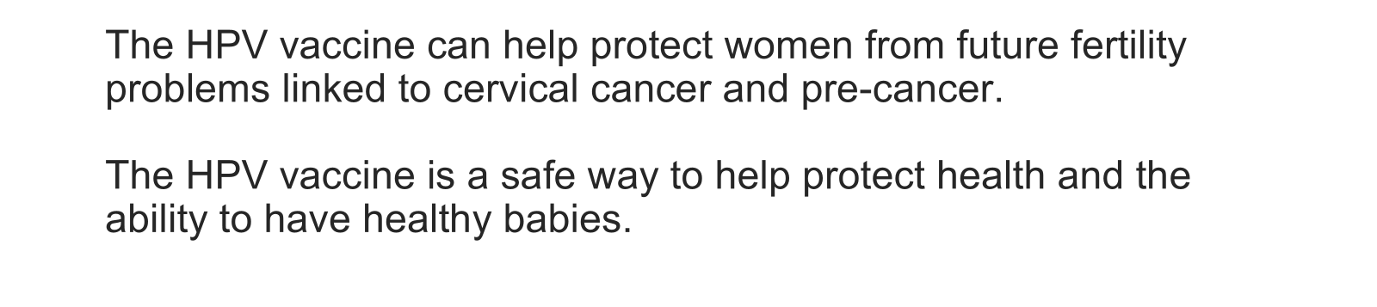
HPV Vaccination Can Protect,
Not Harm, Fertility
Notes:
•To respond to the concern raised in some countries that have recently introduced HPV vaccine, the literature on HPV vaccination and infertility was reviewed.
•The Global Advisory Committee on Vaccine Safety (GACVS) concluded that the available data do not support an association between HPV vaccination and infertility. The current safety profile continues to be extremely favourable, as discussed at 7 previous GACVS meetings, and consistent with the pre-licensure safety profile.²¹ HPV vaccine safety will continue to be monitored and will be reviewed by GACVS as appropriate. GACVS recommends that communications strategies about vaccine safety ensure appropriate understanding of the safety profile.
•The HPV vaccine is very safe and prevents cervical cancer.
•HPV vaccine can protect, not harm, fertility.
•There is no credible evidence that HPV vaccination leads to issues with fertility.
•
References:
WHO The Global Advisory Committee on Vaccine Safety (GVACS): GACVS concluded that the available data do not support an association between HPV vaccination and infertility.
https://www.who.int/groups/global-advisory-committee-on-vaccine-safety/topics/human-papillomavirus-vaccines/infertility

Slide 36
Are HPV Vaccines Safe?
Yes. HPV vaccines are very safe, just like any other vaccine.
Millions of children have safely received HPV vaccines in over 150 countries.
These vaccines are some of the most studied vaccines available, and studies show that they are very safe.
Notes:
*Post-licensure safety data is based on Cervarix and Gardasil vaccines. Clinical trial data from Cervavac (Serum Institute) appear to be in line with these findings
A parent may ask you a version of "is the vaccine safe"
Sample response Yes. The HPV vaccine is very safe. Millions of children have safely received the HPV vaccine in over 150 countries. These vaccines are some of the most studied vaccines on the market and these studies show that they are very safe.
Reference:
World Health Organization. Global Advisory Committee on Vaccine Safety, 2–3 December 2015 [Internet]. 2016 . Available from: https://www.who.int/publications-detail-redirect/who-wer9103-21-32
Phillips A, Patel C, Pillsbury A, Brotherton J, Macartney K. Safety of Human Papillomavirus Vaccines: An Updated Review. Drug Saf [Internet]. 2018 ;41(4):329–46. Available from: https://pubmed.ncbi.nlm.nih.gov/29280070/
Arbyn M, Xu L, Simoens C, Martin‐Hirsch PP. Prophylactic vaccination against human papillomaviruses to prevent cervical cancer and its precursors. Cochrane Database of Systematic Reviews [Internet]. 2018;(5). Available from: https://www.cochranelibrary.com/cdsr/doi/10.1002/14651858.CD009069.pub3/full

Slide 37
FACT:
HPV VACCINATION
STARTS AT AGE 9
Notes:
HPV vaccination is effective at preventing cancer as well as precancer and HPV infections

Slide 38
Benefits of Vaccinating at Early Ages (9-14 years)
Immune response is more robust at young age
Increased likelihood of vaccinating prior to HPV exposure
Opportunities to combine with other childhood/adolescent vaccines
Notes:
Benefits of Vaccinating on-time
Results in a stronger immune response
Increased likelihood of vaccinating prior to first HPV exposure
Opportunities to combine with other childhood/adolescent vaccines
Reference: Saslow et al. Human papillomavirus vaccination 2020 guideline update: American Cancer Society guideline adaptation. CA Cancer J Clin. 2020 Jul;70(4):274-280
Article collection: HPV Vaccination Starting at Age 9 (tandfonline.com)

Slide 39
FACT CHECK 3
Q: HPV vaccine effectiveness __________ as age at vaccination increases.
A: Increases
B: Decreases
C: Stays the same
Please respond in the chat box
Notes:
Q:HPV vaccine effectiveness ____________ as age at vaccination increases.
Correct Answer: B Decreases with age at vaccination

Slide 40
FACT CHECK 3
Q: HPV vaccine effectiveness __________ with age.
A: Increases
B: Decreases (correct answer)
C: Stays the same
Please respond in the chat box
Notes:
Q:HPV vaccine effectiveness ____________with age.
Correct Answer: B Decreases with age

Slide 41
Approved HPV Vaccines
and
Guidelines
Notes:
HPV vaccination is best given on-time, starting at age 9

Slide 42
HPV Vaccine Types
Bivalent
GSK, Innovax, Walvax
HPV 16, 18
Quadrivalent
MSD, Serum
HPV 6, 11, 16, 18
Nonavalent
MSD
HPV 6, 11, 16, 18, 31, 33, 45, 52, 58
HPV vaccines with marketing authorization and/or WHO prequalification
Notes:
HPV Vaccines with marketing authorization and/or WHO prequalification include:
Bivalent (HPV2)
GSK’s Cervarix® with proprietary AS04 adjuvant, indicated for girls and women, boys and men between 9-45 years of age. Cervarix is licensed for girls and boys aged 9–14 years as a 2-dose schedule (5–13 months apart). If the recipient’s age at the time of the first dose is ≥15 years, three doses should be given (at 0, 1–2.5 months and 5–12 months).
Innovax’s Cecolin® with aluminium-containing adjuvant, indicated for girls and women aged 9-45 years. Cecolin is licensed for girls aged 9–14 years as a 2-dose schedule (6 months apart). From age 15, a 3-dose schedule is indicated (at 0, 1–2 months and 5–8 months).
Walrinvax contains an aluminium containing adjuvant, indicated for girls and women aged 9-30 years (developed by its subsidiary Shanghai Zerun Biotech). Walrinvax is licensed for girls aged 9–14 years as a 2-dose schedule (6 months apart, with a minimum interval of 5 months). From age 15, a 3-dose schedule is indicated (at 0, 2–3 and 6–7 months).
Quadrivalent (HPV4)
Merck’s Gardasil® with aluminium-containing adjuvant, indicated from 9-45 years of age for girls and women, boys and men. Gardasil is licensed for girls and boys aged 9–13 years as a 2-dose schedule (6 months apart). From age 14, a 3-dose schedule should be given (at 0, 1–2 and 4–6 months).
Cervavax is is licensed for girls and boys aged 9–14 years, as a 2-dose schedule (6 months apart). From age 15, a 3-dose schedule should be given (at 0, 2 and 6 months).
Nonavalent (HPV9)
Merck’s Gardasil 9® with aluminium-containing adjuvant, indicated from 9-45 years of age for girls and women, boys and men. is licensed for girls and boys aged 9–14 years as a 2-dose schedule (5–13 months apart). From age 15, a 3-dose schedule should be followed (at 0, 1–2 and 4-6 months).
Choice of HPV vaccine: Current evidence suggests that, from a public health perspective, all currently licensed bivalent, quadrivalent and nonavalent vaccines offer comparable immunogenicity, efficacy and effectiveness for the prevention of cervical precancer and cancer, which is mainly caused by HPV types 16 and 18.
The choice of HPV vaccine should be based on an assessment of locally relevant data and on a number of considerations, including: the scale of the prevailing HPV-associated public health problem (cervical cancer, other HPV-associated cancers, anogenital warts); the population for which the vaccine has been approved; product characteristics, including data on single-dose efficacy; price; and programme considerations.
***The best HPV vaccine is the one that is available and licensed in your country. All HPV vaccines on the market protect against types 16 and 18 which protect against 70% of cervix cancers.
Reference:
https://iris.who.int/bitstream/handle/10665/365350/WER9750-eng-fre.pdf?sequence=1
WER9750-eng-fre.pdf (who.int)
who-mi4a-global-market-study-hpv.pdf

Slide 43
CDSCO-Approved HPV Vaccines in India
Bivalent
GSK
Females
HPV 16,18
Quadrivalent Serum Institute of India
Females and Males
HPV 16,18, 6, 11
Quadrivalent MSD
Females
HPV 16,18, 6, 11
9-valent MSD
Females and Males
HPV 16,18, 6, 11, 31, 33, 45, 52, 58
No longer available in India
Notes:
The CDSCO has approved 4 HPV vaccines as of 2025.
Date of Approval:
GSK Bivalent - 2008
MSD Quadrivalent - 2008
MSD Nonavalent – 2018
SII Quadrivalent – 2022
Schedule for Any Brand:
9-14 years: 2 doses at 0 and 6 months
Above 14 and immunocompromised: 3 doses at 0, 2, and 6 months
Ages:
Bivalent (CERVARIX by GSK) licensed for girls 10–45 years.
Quadrivalent (Cervavac by SIL) licensed for girls and boys 9–26 years.
Quadrivalent (Gardasil by MERCK) licensed for girls 9–45 years.
Nonavalent (Gardasil by MERCK) licensed for girls 9–26 years AT 3-DOSE regimen (0,2,6); Boys 9 - 14 years at 0,2,6 months 
Sankaranarayanan R, Basu P, Kaur P, Bhaskar R, Singh GB, Denzongpa P, et al Current status of human papillomavirus vaccination in India's cervical cancer prevention efforts. Lancet Oncol. 2019 ;20(11):e637-e644. Available from https://pubmed.ncbi.nlm.nih.gov/31674322/
https://www.livemint.com/news/india/serum-institute-s-qhpv-vaccine-against-cervical-cancer-gets-india-regulator-dgci-s-nod-11657630152069.html
Details of import permissions of Human Vaccines approved by CDSCO (2009 to 2022). Available from: https://cdsco.gov.in/opencms/resources/UploadCDSCOWeb/2018/UploadVaccineImport/Details%20of%20Import%20Permissions%20of%20Human%20Vaccines%20approved%20by%20CDSCO%20(2009%20-%206th%20Oct.%202022).pdf
HPV vaccination in south Asia: new progress, old challenges. Lancet Oncol. 2022. 23(10):1233. Available from: https://www.thelancet.com/journals/lanonc/article/PIIS1470-2045(22)00567-8/fulltext

Slide 44


HPV Vaccine Recommendation
FOGSI GCPR 2023, NTAGI
(National Advisory Group on Immunisation)
On Time
Ages 9-14
Feb. 2026 - Govt. of India campaign begins with single-dose schedule for 14 year old girls
Vaccinated girls should also follow cervical screening guidelines in adulthood
Source: NTAGI, WHO
Notes:
HPV Vaccination Guidelines:
MOHFW ( Ministry of Health and Family Welfare) announcements and FOGSI GCPR as well as IAP Immunization Schedule strongly recommend vaccination for the primary target group of girls ages 9 – 14.
In 2023, NTAGI recommended introduction of the HPV Vaccine in the Universal Immunization Programme (UIP) with a one-time catch-up for 9-14 year-old girls followed with routine vaccination at age 9. The 2026 GOI vaccination campaign is covering only 14 year olds with free vaccination as of May 2026.
IAP updated their recommendations to reflect the single-dose schedule.
FOGSI recommendations are yet to be updated as of April 2026 to reflect the single-dose schedule.
Vaccination at Older Ages:
The vaccine is also labeled for women up to age 45. However, the vaccine is not a therapeutic vaccine and will not treat existing pathology.
There is reduced efficacy in older women as most people first contract HPV in their teens and early 20.
FOGSI GCPR 2023 suggests a 3-dose regimen for older women, evaluating the evidence as level II grade B
Recommending it to women in adulthood may lead those women to think their daughters can wait to get vaccinated and potentially reduce the likelihood of on-time vaccination for girls.
Sources:
Minutes of the Meeting: 17th National Technical Advisory Group on Immunization (NTAGI)Meeting. https://www.mohfw-dohfw.gov.in/static/uploads/2025/12/ebb2ee6cf3a615a8741377d3c3bbd19e.pdf
Human papillomavirus vaccination: Good clinical practice recommendations from the Federation of Obstetric and Gynecological Societies of India. https://www.fogsi.org/fogsi-gcpr-on-prevention-and-management-of-cervical-cancer-june-2023/
IAP. Recommended Immunization Schedule (2025) and Update on Immunization for Children Aged 0 Through 18 Years. https://link.springer.com/article/10.1007/s13312-026-00311-w
Oliveira C, Shapiro E, Sheth S et al. Clinical effectiveness of HPV vaccine by age at vaccination: a matched case-control study. The Lancet Regional Health – Americas, 2025; 5 https://www.thelancet.com/journals/lanam/article/PIIS2667-193X(25)00235-2/fulltext

Slide 45
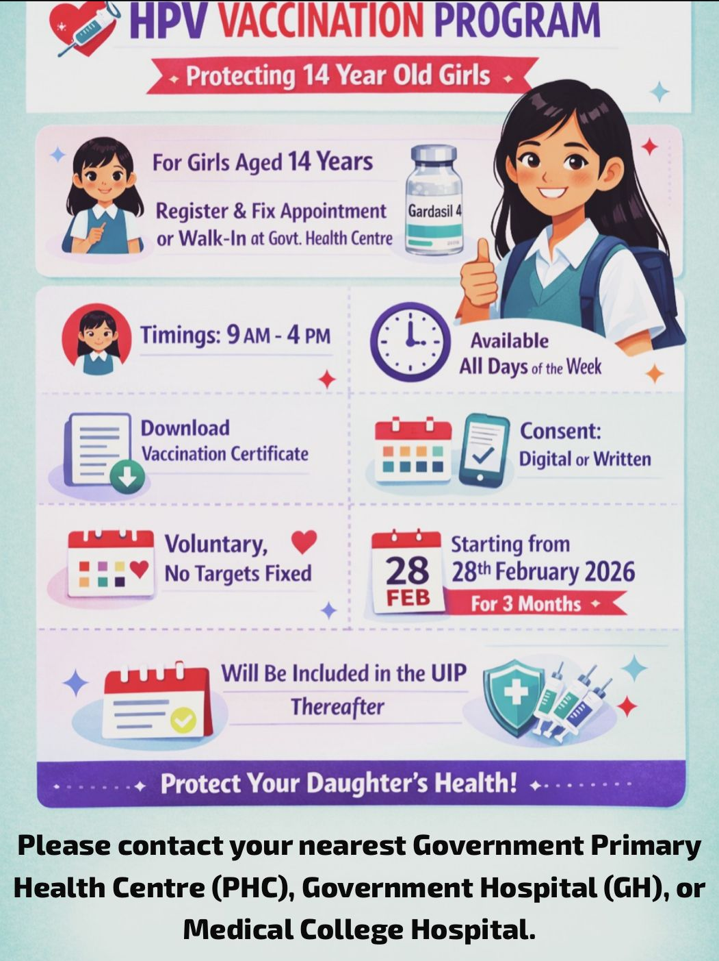
India’s HPV Vaccine campaign
Govt. of India begins campaign to vaccinate 14-year-old girls across the country
Notes:
In February 2026, the Government of India rolled-out an HPV vaccination campaign starting with 14 year old girls. After the campaign phase, the vaccine will be available for 14 year old girls on routine immunization session days. The government chose to begin with the upper end of the recommended age range to avoid “missing” girls who are already older but can greatly benefit from vaccination. NTAGI’s recommendation to vaccinate at ages 9-14 makes it possible that GOI will add additional ages in the future.
Source:
Ministry of Health and Family Welfare. Prime Minister Shri Narendra Modi Launches Nationwide HPV Vaccination Drive for 14-Year-Old Girls from Ajmer, Rajasthan. https://www.pib.gov.in/PressReleasePage.aspx?PRID=2233906&reg=3&lang=2

Slide 46
HPV Vaccine
Shifting Global Landscape
Notes:
HPV vaccination is best given on-time, starting at age 9

Slide 47
Shifting Global Landscape
More than 75% of countries introduced HPV vaccine in national immunisation programmes
Single Dose: More than half (low-, middle-, and high-income) adopted off-label single-dose HPV vaccination (2026)
Delivery to boys and girls: About ⅓ offer gender-neutral vaccination
Data accessed April 2026
Notes:
Data as of April 2026
More than 75% countries have introduced HPV vaccine in national immunisation programme
Single Dose: More than half of these countries have adopted a1-dose HPV vaccine schedule including high income, middle income and lower income countries
HPV Vaccine delivery by sex:
Around ⅓ of these countries are covering vaccination for both girls and boys while roughly 2/3s are offering vaccination only for girls.
Source:
IVAC View-hub. https://view-hub.org/topics/single-dose-hpv#:~:text=Of%20the%20165%20countries%20that,after%20the%20updated%20WHO%20recommendation
WHO HPV Targeted Sex: Immunization, Vaccines and Biologicals
WHO: 1 Dose Schedule: Immunization, Vaccines and Biologicals

Slide 48
FACT CHECK 4
Q: At what age does NTAGI recommend starting HPV vaccine?
A: 9
B: 12
C: 15
D: 25
Please respond in the chat box
Notes:
Q: What age does NTAGI recommend HPV vaccine start at?
Answer: A, Age 9

Slide 49
FACT CHECK 4
Q: At what age does NTAGI recommend starting HPV vaccine?
A: 9 (Correct Answer)
B: 12
C: 15
D: 25
Please respond in the chat box
Notes:
Q: What age does NTAGI recommend HPV vaccine start at?
Answer: A Age 9
Do not confuse recommended age with the age that vaccination is provided for free (14)

Slide 50
FACT:
Doctors’ Recommendations Matter
(Communication)

Slide 51

Your Recommendation Matters
Parents consider healthcare providers the
most credible source
of information on
HPV vaccination.
Models used for illustrative purposes only.
Notes:
Research shows that parents consider healthcare providers the most credible sources for information on HPV vaccination.
Sources:
Our Research - Prevent Global HPV Cancers https://preventglobalhpvcancers.org/our-research/
European Journal of Obstetrics & Gynecology and Reproductive Biology 2026, https://www.sciencedirect.com/science/article/pii/S0301211525011613.
International Journal of Environmental Research and Public Health 2025, https://doi.org/10.3390/ijerph22010069
Human Vaccines & Immunotherapeutics 2024, https://pmc.ncbi.nlm.nih.gov/articles/PMC10773709/

Slide 52
Parents Trust Doctors
“The position of the doctor is after god. Only doctors can cure us. They are very caring and answer all our questions.” –Mother, Kolkata
"When the doctor tells me something related to my child’s health, I trust him. Since he is attentive to my queries and doubts, it helps increase my trust in him. We go to the doctor to cure our diseases, and it is the doctor that heals us. So, we have to rely on the doctor and the opinion of the doctor must be given importance.”
– Father, Howrah
Notes:
As doctors, parents place a high degree of trust in our recommendation. It is our responsibility to recommend the HPV vaccine to help parents protect their daughters from cervical cancer
“The position of the doctor is after god. Only doctors can cure us. They are very caring and answer all our questions.” – Mother, Kolkata
"When the doctor tells me something related to my child’s health, I trust him. Since he is attentive to my queries and doubts, it helps increase my trust in him. We go to the doctor to cure our diseases, and it is the doctor that heals us. So, we have to rely on the doctor and the opinion of the doctor must be given importance.”
We have a great responsibility to provide parents clear recommendations and fact-based information for their questions.
Reference:
https://preventglobalhpvcancers.org/wp-content/uploads/2023/03/Overcoming-Barriers-to-HPV-Vaccination-Among-Physicians-in-India-Final-Research-Report.pdf

Slide 53
HPV Vaccine Recommendation Roadmap
Recommend
Listen (to parents’ questions)
Respond

Slide 54
Make a Positive Recommendation
Age 14
1. Note child's age.
2. Tell the parent that girls this age are due for a vaccine that helps prevent cervical cancer.
3. Recommend that they vaccinate.
“Preeti is 14 years old which means she needs her HPV vaccine, which helps protect her from cervical cancer and other HPV cancers. Cervical cancer is very common in India. I recommend she get the HPV vaccine."
Adapted from Hpviq.org
Notes:
Once you’ve established that the patient is between 9 – 14 and has not received the HPV vaccine or completed the series, make a clear recommendation.
Note the child’s age, let them know that all girls at this age are due for a vaccine that prevents cervical cancer. Recommend that they vaccinate, simply and clearly
You can use this sample text for girls aged 14 and let parents know that girls age 14 can get the vaccine for free at government health centres. It’s important to share this information to maintain trust with parents, even if the parent ultimately chooses to vaccinate at cost in a private facility.
Source: https://www.hpviq.org/
National Cancer Institute. Cancer Prevention Message Is Key for HPV Vaccination Discussions with Parents [Internet]. 2018 . Available from:
https://www.cdc.gov/hpv/hcp/answering-questions.html

Slide 55
Make a Positive Recommendation (cont.)
Ages 9-13
1. Note child's age.
2. Tell the parent that girls this age are due for a vaccine that helps prevent cervical cancer.
3. Recommend that they vaccinate.
“Preeti is 9 years old, which means she needs her HPV vaccine, which helps protect her from cervical cancer and 4 other HPV cancers.
It works best when given between ages 9 and 14. The government gives it free at age 14 in government clinics. I recommend she get the HPV vaccine as soon as possible."
Notes:
Once you’ve established that the patient is between 9 – 14 and has not received the HPV vaccine or completed the series, make a clear recommendation.
Note the child’s age, let them know that all girls at this age are due for a vaccine that prevents cervical cancer. Recommend that they vaccinate.
Also let them know that girls age 14 can get the vaccine for free at government health centres. You can recommend they not wait until age 14. Reasons to vaccinate earlier include that the vaccine is more effective at younger ages and it reduces the chances of missing on-time vaccination
**Note that this messaging has not been tested in practice. We would love to hear about your experience to learn more about effectiveness in real-world settings.

Slide 56
Tip:
Focus on HPV vaccination as Cancer Prevention
Parent: My child doesn't need this vaccine because she's not married.
Doctor: I understand. Many vaccines are given at younger ages to protect from future diseases. The HPV vaccine prevents cervical cancer in her future and works best when given between ages 9-14.
Adapted from Hpviq.org
Notes:
Tip:
Always focus on HPV vaccination as cancer prevention
For example, if sex or marriage comes up, redirect the discussion to cancer prevention
Example:
Parent: My child doesn't need this vaccine because she's not married/having sex.
Doc: I understand. Vaccines are given at younger ages to protect from future diseases. The HPV vaccine is about preventing cervical cancer and works best when given between ages 9-14.

Slide 57
Tip:
Most parents will not come in seeking an HPV vaccine
You will need to find opportunities to proactively recommend the HPV vaccine to parents of 9 to 14-year-olds.
Adapted from Hpviq.org
Notes:
Tip:
Most parents will not come in seeking an HPV vaccine
You will need to find/make opportunities to proactively recommend the HPV vaccine to parents of 9 to 14-year-olds

Slide 58
If a Parent Has Questions
Doctor: It's best to vaccinate when they are younger because we will prevent the most HPV cancers at that age.
Respond with brief, fact-based messages.
Doctor: This is an HPV cancer preventing vaccine. I strongly recommend you get it for your daughter.
Adapted from Hpviq.org
Notes:
Address the parent's concern using a fact-based message
Follow-up by clearly recommending they get the HPV vaccine
References
Goleman MJ, Dolce M, Morack J. Acad Pediatr. 2018;18:769-775
St Sauver, et al. Prev Med. 2016;89:327-333
Biancarelli et al. J Pediatr. 2020;217:92-97
Falcaro M, Castañon A, Ndlela B, Checchi M, Soldan K, Lopez-Bernal J,et al .The effects of the national HPV vaccination programme in England, UK, on cervical cancer and grade 3 cervical intraepithelial neoplasia incidence: a register-based observational study. Lancet. 2021 ;398(10316):2084-2092. Available from.https://pubmed.ncbi.nlm.nih.gov/34741816/

Slide 59

ROLE PLAY 1
Clinical Scenario
A parent has brought their 10-year-old daughter to your clinic for a non-serious sports injury.
Use this opportunity to make an HPV vaccine recommendation.
Role play how you would make an HPV vaccine recommendation to the parent.
Notes:
Role Play:
A parent has brought their 10-year-old daughter to your clinic for a non-serious sports injury.
Use this opportunity to make an HPV recommendation.
Role play how you would make an HPV vaccine recommendation to the parent

Slide 60
ROLE PLAY 2
Clinical Scenario
A parent comes with their 10-year-old daughter to your clinic for HPV vaccination. He has come to know about the vaccine from the media.
The concerned father asks “Is the HPV vaccine safe?” You address the safety issue and administer the vaccine.
Role play how you might respond with a short, fact-based response.
Notes:
1. Note child's age.
2. Tell the parent that girls this age are due for a vaccine that helps prevent cervical cancer.
3. Recommend that they vaccinate.
“Preeti is 10 years old which means she needs her first dose of the HPV vaccine, which helps protect her from cervical cancer and other HPV cancers. I recommend she get the HPV vaccine."

Slide 61
Questions Parents May Ask

Slide 62

Does HPV Vaccination Work?
Yes, HPV vaccination works very well.
Studies have proven that HPV vaccination is effective at preventing cervical and other HPV cancers.
HPV vaccination can prevent most cervical cancers.
Notes:
A parent may ask "How do you know it works?"
Sample response
Yes, HPV vaccination works very well.
Studies have proven that the vaccines are effective at preventing cervical and other HPV cancers.
HPV vaccination can prevent most cervical cancers.
Source: Lehtinen M, Lagheden C, Luostarinen T, Eriksson T, Apter D, Bly A, et al. Human papillomavirus vaccine efficacy against invasive, HPV-positive cancers: population-based follow-up of a cluster-randomised trial. BMJ Open. 2021 ;11(12):e050669. Available from .Human papillomavirus vaccine efficacy against invasive, HPV-positive cancers: population-based follow-up of a cluster-randomised trial - PubMed (nih.gov)
National Cancer Institute, 2020. Large Study Confirms that HPV Vaccine Prevents Cervical Cancer. [Internet] Avaiable from https://www.cancer.gov/news-events/cancer-currents-blog/2020/hpv-vaccine-prevents-cervical-cancer-sweden-study

Slide 63
Does the HPV Vaccine Cause Side Effects?
The HPV vaccine is safe.
As with any other injection, your child may have mild side effects, such as fever or redness at the site of injection.
Very rarely, a child can have an allergic reaction to any injection. As with all injections, we will keep your child seated for 10-15 minutes.
Notes:
A parent asks a version of "Does the HPV vaccine cause side effects?
A sample response:
HPV vaccine is a safe vaccine.
As with any other injection, your child may have mild side effects, such as fever or redness at the site of injection.
Very rarely a child can have an allergic reaction to any injection. As with all injections, we will keep your child seated for 10-15 minutes.
Source: WHO. Observed Rate of Vaccine Reactions with Human Papilloma Virus Vaccine. https://cdn.who.int/media/docs/default-source/pvg/global-vaccine-safety/hpv-vaccine-rates-information-sheet.pdf?sfvrsn=d2f2750_5&download=true
Cochrane. New research confirms HPV vaccination prevents cervical cancer. https://www.cochrane.org/about-us/news/new-research-confirms-hpv-vaccination-prevents-cervical-cancer

Slide 64
Will HPV Vaccination Harm My Daughter’s Fertility?
NO
HPV vaccination does not cause fertility problems.
HPV vaccination can help protect fertility by preventing most cervical precancers and cancers.
Notes:
A parent may ask "Will HPV vaccination harm my daughter's fertility?"
Sample response: No. HPV vaccination does not cause fertility problems.
The HPV vaccine can help protect women from future fertility problems linked to treatment of cervical pre-cancer and cancer.
The HPV vaccine is a safe way to help protect health and the ability to have healthy babies.
Source:
World Health Organization. Human papilloma virus vaccines and infertility: Extract from GACVS meeting of 4-5 December 2019, published in the WHO Weekly Epidemiological Record of 24 January 2020. [Internet] Available from
https://www.who.int/groups/global-advisory-committee-on-vaccine-safety/topics/human-papillomavirus-vaccines/infertility
Bjorge, et al., 2016, Obstet Gynecol; Sadler, 2004, JAMA
Insinga, 2005, Pharmocoeconomics,
Yuill, 2023, Hum Vacc Immunother

Slide 65
Can She Get the Vaccine After Marriage?
The HPV vaccine is recommended for all girls aged 9 - 14 and is not based on marital status.
Most vaccines are given at younger ages to protect from diseases in the future.
HPV vaccination works best when given between ages 9 and 14.
Research shows that on-time vaccination provides more protection from HPV cancers than late vaccination at older ages.
Notes:
"Can she not get the vaccine after marriage?“
Sample response
"The HPV vaccine is recommended for all girls age 9 - 14 and is not based on marital status.
Most vaccines are given at younger ages to protect from diseases in the future.
HPV vaccination works best when given between ages 9 and 14.
Research shows that on-time vaccination provides more protection from HPV cancers than late vaccination at older ages.
Sources:
Falcaro M, Castañon A, Ndlela B, Checchi M, Soldan K, Lopez-Bernal J, et al. The effects of the national HPV vaccination programme in England, UK, on cervical cancer and grade 3 cervical intraepithelial neoplasia incidence: a register-based observational study. Lancet. 2021 ;398(10316):2084-2092. Available from https://pubmed.ncbi.nlm.nih.gov/34741816/
WHO, Human papillomavirus vaccines: WHO position paper, May 2017 position paper [Internet}. Available from https://www.who.int/teams/immunization-vaccines-and-biologicals/policies/position-papers/human-papillomavirus-(hpv)
Lehtinen M, Lagheden C, Luostarinen T, Eriksson T, Apter D, Bly A, et al. Human papillomavirus vaccine efficacy against invasive, HPV-positive cancers: population-based follow-up of a cluster-randomised trial. BMJ Open. 2021 ;11(12):e050669. Available from .Human papillomavirus vaccine efficacy against invasive, HPV-positive cancers: population-based follow-up of a cluster-randomised trial - PubMed (nih.gov)
National Cancer Institute, 2020. Large Study Confirms that HPV Vaccine Prevents Cervical Cancer. [Internet] Avaiable from https://www.cancer.gov/news-events/cancer-currents-blog/2020/hpv-vaccine-prevents-cervical-cancer-sweden-study

Slide 66
Is There a Cost to the Vaccine?
For girls age 14, the government of India is providing free HPV vaccines.
Girls of other ages and boys can get vaccinated at a cost
Today the cost is ____ for the vaccine and ____ for delivery.
Notes:
Is there a cost to the vaccine?
Input local costs.
Let parents know that 14-year-old girls can get vaccinated free at government health facilities and that girls of other age groups and boys can get vaccinated at cost. Discuss the risks of waiting to vaccinate (for younger girls) vs. cost savings and allow them to choose.

Slide 67
Can Boys Get the HPV Vaccine?
Yes, the HPV vaccine can be given to both boys and girls to prevent HPV cancers as they grow older.
Notes:
Can boys get the HPV vaccine?
Yes, the HPV vaccine can be given to both boys and girls to prevent HPV cancers as they grow older.
If parents question why the focus of vaccination campaigns has been on girls, not boys, you can tell them that HPV cancers in women (particularly cervical cancer) are much higher than in men so the initial focus is on vaccinating girls.

Slide 68
FACT CHECK 5
Q: Parents respond best if you frame HPV vaccination as:
A: An optional vaccine
B: Cancer prevention
C: Sexually transmitted disease prevention
Please respond in the chat box
Notes:
Q: Parents respond best if you frame HPV vaccination as:
Answer: B Cancer Prevention

Slide 69
FACT CHECK 5
Q: Parents respond best if you frame HPV vaccination as:
A: An optional vaccine
B: Cancer prevention
C: Sexually transmitted disease prevention
Please respond in the chat box
Notes:
Q: Parents respond best if you frame HPV vaccination as:
Answer: B Cancer Prevention

Slide 70
What Questions
Do You Have?
Q & A

Slide 71
Doctors are Critical to Cervical Cancer Elimination
1
Doctors are the most trusted source of HPV vaccination information for parents.
2
Increasing HPV vaccine coverage in girls can save many lives.
3
Most cervical cancers can be prevented through HPV vaccination.
4
We can eliminate cervical cancer!
Models used for illustrative purposes only.
Notes:
With so many competing priorities for your time, why should you focus on HPV vaccination?
We are at a pivotal time:
As a physicians, you are the most trusted source of HPV vaccination information for parents
Increasing HPV vaccine coverage in girls can save lives. More than 70k women die of cervical cancer in India each year, most of these can be saved.
Most cervical cancers can be prevented through HPV vaccination (The exact percentage depends on age at vaccination, type of vaccine used, and types of HPV circulating in local population, but it’s >70% in most places)
For the first time in history, we can eliminate a cancer!
Source
International Agency for Research on Cancer. India Human Papillomavirus and Related Cancers, Fact Sheet 2023. [Internet]. 2023 . Available from: https://hpvcentre.net/statistics/reports/IND_FS.pdf
Kaarthigeyan K. Cervical cancer in India and HPV vaccination. Indian J Med Paediatr Oncol. 2012 ;33(1):7-12. Available from https://www.ncbi.nlm.nih.gov/pmc/articles/PMC3385284/#ref3
https://www.who.int/publications/i/item/WHO-NMH-NVI-17.9
https://www.thelancet.com/journals/lancet/article/PIIS0140-6736(20)32657-X/fulltext

Slide 72
Key Takeaways
HPV can cause
6 types of cancer
HPV is very common
HPV vaccine is safe
Not enough children are being protected
Not enough children are being protected
HPV vaccine is effective
Your recommendation matters
Take Action: Recommend the HPV vaccine to all 9 to 14-year-old girls in your practice
Notes:
HPV exposure is very common
HPV can cause 6 types of cancers
HPV vaccine is safe
HPV vaccine is effective
Not enough children are being protected
Take Action: recommend the HPV vaccine to all 9-14 year olds in your practice

Slide 73

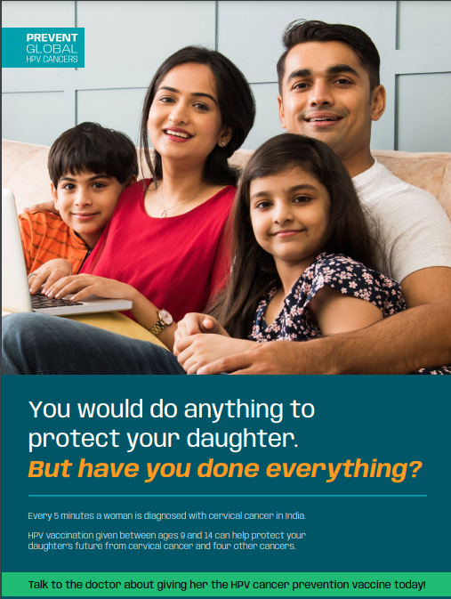
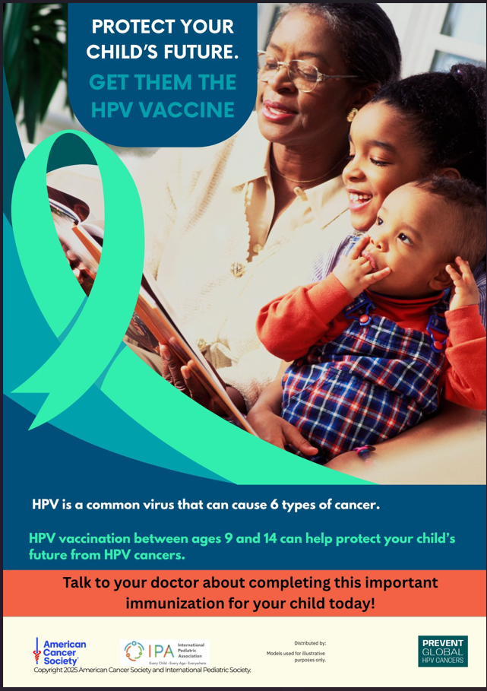
Resources
Answers to Frequently Asked Questions by Parents, Clinic Posters, & Parent Handouts
Find all resources on www.PreventGlobalHPVCancers.org
Notes:
Many resources have been created in collaboration with physicians across countries and are available to support you in recommending HPV vaccination.
Just the Facts for HPV vaccination
Counseling Parents
Clinic Posters
Parent handout and more
Find all these resources at www.PreventGlobalHPVCancers.org

Slide 74
Training Post Survey
Notes:
Pause for 2-3 minutes to make sure training participants access and complete the post-training survey.
In a virtual training please post the survey link into the chat

Slide 75
You have the power to make sure that no girl grows up in your community to hear these dreaded words, "you have cervical cancer."
Notes:
You have the power to make sure that no girl grows up in your community to hear the dreaded words "you have cervical cancer"

Slide 76
Acknowledgement:
Expert review of this original content was coordinated by
The Cancer Foundation of India
and
The American Cancer Society
Content may have been edited and is not representative of the views of
The Cancer Foundation of India or the American Cancer Society.
The Cancer Foundation of India and the American Cancer Society
do not endorse any company, product, or service.
Notes:
Disclaimer:
Expert review of this original content was coordinated by the Cancer Foundation of India and the American Cancer Society's Global HPV Cancer Free program.
The American Cancer Society does not endorse any company, product, or service.

Slide 77
Appendix of
Additional Questions
(for speakers only)
Notes:
Let's review some questions you may get from parents.

Slide 78
Why Do They Need HPV Vaccine at This Age?
Q & A
Most vaccines are given at younger ages to protect from diseases in the future.
HPV vaccination works best when given between ages 9 and 14 before chance of exposure.
Research shows that on-time vaccination provides more protection from HPV cancers than late vaccination at older ages.
Notes:
A parent may ask "Why do they need it at this age?"
Sample response,
Most vaccines are given at younger ages to protect from diseases in the future.
HPV vaccination works best when given between ages 9 and 14 before chance of exposure.
Research shows that on-time vaccination provides more protection from HPV cancers than late vaccination at older ages.
SOURCES:
Falcaro M, Castañon A, Ndlela B, Checchi M, Soldan K, Lopez-Bernal J, et al. The effects of the national HPV vaccination programme in England, UK, on cervical cancer and grade 3 cervical intraepithelial neoplasia incidence: a register-based observational study. Lancet. 2021 ;398(10316):2084-2092. Available from https://pubmed.ncbi.nlm.nih.gov/34741816/
WHO, Human papillomavirus vaccines: WHO position paper, May 2017 position paper [Internet}. Available from https://www.who.int/teams/immunization-vaccines-and-biologicals/policies/position-papers/human-papillomavirus-(hpv)

Slide 79
How Long Will the Protection From the HPV Vaccine Last?
Q & A
The HPV vaccine provides long-lasting protection.
There is enough evidence to suggest that immunity given by HPV vaccination lasts well into adulthood.
There is no indication that the vaccine protection lessens with time. No booster is needed.
Notes:
How long will the HPV vaccine last?
The HPV vaccine provides long-lasting protection.
There is enough evidence to suggest that immunity given by HPV vaccination lasts well into adulthood.
There is no indication that the vaccine protection lessens with time.

Slide 80
Is My Child Really at Risk for HPV Infection?
Q & A
HPV is a very common infection.
Before HPV vaccines, nearly everyone got an HPV infection at some point in their lives.
On-time HPV vaccination will help protect your daughter from cancer that is caused by HPV.
Notes:
"Is my child really at risk for HPV infection?"
Sample response,
HPV is a very common infection.
Before HPV vaccines, nearly everyone got an HPV infection at some point in their lives.
On-time HPV vaccination will help protect your daughter from cancer that can be caused by HPV.
SOURCES Lehtinen M, Lagheden C, Luostarinen T, Eriksson T, Apter D, Bly A, et al. Human papillomavirus vaccine efficacy against invasive, HPV-positive cancers: population-based follow-up of a cluster-randomised trial. BMJ Open. 2021 ;11(12):e050669. Available from .Human papillomavirus vaccine efficacy against invasive, HPV-positive cancers: population-based follow-up of a cluster-randomised trial - PubMed (nih.gov)
National Cancer Institute, 2020. Large Study Confirms that HPV Vaccine Prevents Cervical Cancer. [Internet] Avaiable from https://www.cancer.gov/news-events/cancer-currents-blog/2020/hpv-vaccine-prevents-cervical-cancer-sweden-study

Slide 81
Why Does My Child Need HPV Vaccination?
Q & A
HPV vaccination is important because it will protect your daughter from HPV infections that can cause cervical and four other types of cancer (throat, vagina, vulva, and anus) when she is older.
On-time vaccination, between 9-14 years, provides the best protection.
Notes:
Why does my child need HPV vaccination?
HPV vaccination is important because it will protect your daughter from HPV infections that can cause cervical and four other types of cancer (throat, vagina, vulva, and anus) when she is older.
On-time vaccination, between 9-14 years, provides the best protection.

Slide 82
Which Cancers are Caused by HPV?
Q & A
HPV, or human papillomavirus, is a common virus that can cause six types of cancer.
In women, HPV can cause cervical, throat, anal, vaginal, and vulvar cancer.
In men, HPV can cause throat, anal, and penile cancer.
Notes:
What cancers are caused by HPV?
HPV, or human papillomavirus, is a common virus that can cause six types of cancer.
In women, HPV can cause cervical, throat, anal, vaginal, and vulvar cancer.
In men, HPV can cause throat, anal, and penile cancer.

Slide 83
Would You Give the HPV Vaccine to Your Children?
Q & A
Yes, my children (or grandchildren) got the HPV vaccine to protect them from HPV cancers.
OR
If I had children or grandchildren that were 9-14, I would get them vaccinated to help protect them from HPV cancers.
Notes:
Would you give the HPV vaccine to your children?
Yes, my children (or grandchildren) got the HPV vaccine because it is very safe and it protects them from cancer.
OR
If I had children or grandchildren that were 9-14, I would get them vaccinated to help protect them from cancer in the future.

Slide 84
Should There Be a Gap Between HPV Vaccination and Other Pre-teen and Teen Vaccines?
Q & A
HPV vaccines may be safely administered along with Td/Tdap, flu, and COVID-19 vaccines.
Notes:
Should there be a gap between HPV vaccination and other pre-teen and teen vaccines?
HPV vaccination may be safely administered along with Td/Tdap, flu as well as COVID-19 vaccine.

